Slide 1

College Library Management System

Slide 2

BACKGROUND OF PROJECT
Library Management System is an application used by librarian to manage the library using a computerized system where he/she can record various transactions like issue of books, return of books, addition of new books, addition of new students etc.

Slide 3

Functional Requirements

Slide 4

Register new book
This feature allows to store new books information to the library database (Oracle).

Slide 5

Functional Requirements
System must be able to not allow two books having same book id.
System must be able to enter number of copies into table.
System must be able to verify information like book name, author name, publisher name etc.

Slide 6

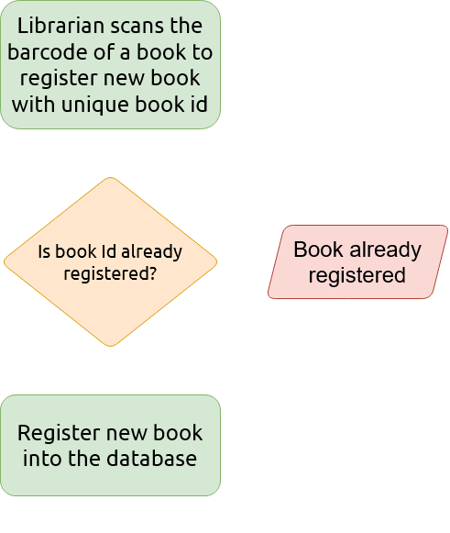

.
.
.
.
.
.
.
.
.
Register new book
.
.
.
.

Slide 7

MODIFY DATA
This feature allows to modify the library data like author name, publisher name, year , etc.

Slide 8
Functional requirements
System must be able to modify the book details.
System must not allow to modify book id.

Slide 9

SEARCH A BOOK
This feature allows to search a book based on :
Book id for Book.
Sem, branch for book information.

Slide 10

Functional requirements
System must be able to search the database based on select search type.
System must be able to filter book based on keyword selected/given.
System must be able to show the filtered book in row view.

Slide 11
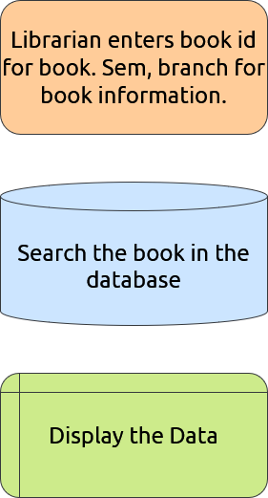
.
.
.
.
.
.
.
.
Search a book
.
.
.

Slide 12

ISSUE BOOKS AND RETURN BOOKS
This feature allows to issue and return books and also view Book Id and Issue date.

Slide 13

Functional requirements
S
System must verify the student eligibility.
System must verify maximum limit a student can borrow books.
System must be able to update number of books.
n
86

Slide 14
Functional requirements
System should be able to enter issue date information in database.
System must verify Book Id in database before issuing a book.

Slide 15
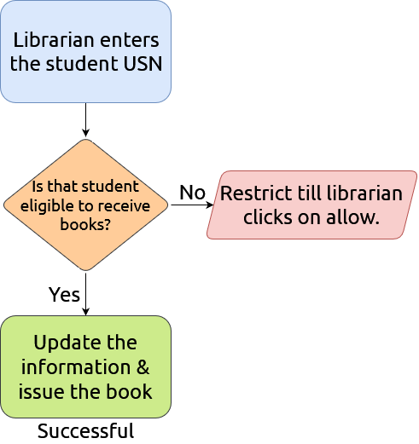
Issue books
The librarian scans the barcode of the book and enters the book id and updates the Issue books data.

Slide 16
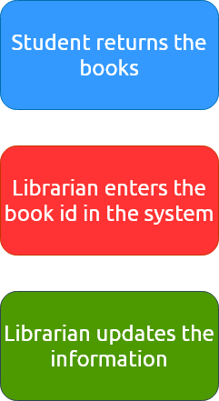
Return books
When Book is returned the Book ID in issue books for that student will be deleted automatically.

Slide 17


SYSTEM REQUIREMENTS
Processor | Intel core i3 or i5
Memory | 2GB RAM – 4GB RAM
Hard disk space | Minimum 1GB space.
Operating system | Windows 10
Database | Oracle(SQL)
Java JDK | 13.0.2

Slide 18

DEVELOPING TOOLS
Programming language | JAVA x Swing GUI Swing in Java is a lightweight GUI toolkit which has a wide variety of widgets for building optimized window based applications. It is a part of the JFC( Java Foundation Classes). It is build on top of the AWT API and entirely written in java.
Database | ORACLE It is easy to maintain and retrieve records by simple queries.

Slide 19
Thanks!
Project By :
Durga Prasad A G
Firoz P
Raghavendra Rahul G V
Sharath K

Slide 20
Credits
Special thanks to all the people who made and released these awesome resources for free:
Presentation templates by SlidesCarnival (slidescarnival.com)
Flowchart maker by diagrams.net
Illustrations by Flaticons (flaticon.com)

